Slide 1
Easing-and-Splines for UI Animations
Alex Garcia Selma

Slide 2
INDEX
Easing
What is an Easing?
Types of Easings
Spline
What is an Spline?
Code

Slide 3

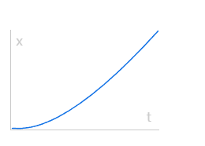
What is an Easing?
A easing is an animation made by a mathematic function
Is used for UI animation to made it more smooth and natural
You cane use it for camera and obstacles movement too.

Slide 4
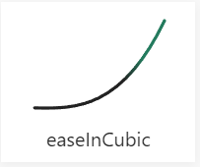
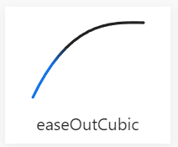
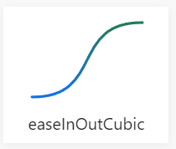
Types of Easings
You have three types of easings:
easeIn: Descrive a positive acceleration of the object.
easeOut: Desctive a negative acceleration of the object
easeInOut: Mixes both of the previous functions
https://easings.net/#

Slide 5
What is a Spline?
The splines are used in coding because they are easy to use and accurate
They can be used to do a difficult moveset in an easy way.
Calculate the experiece that a Player needs to level up.
The camera in Sonic is a good example.

Slide 6
Coding
Hangout (With TODO)
(https://github.com/MaralGS/Easing-and-Splines-for-UI-Animations)

Slide 7
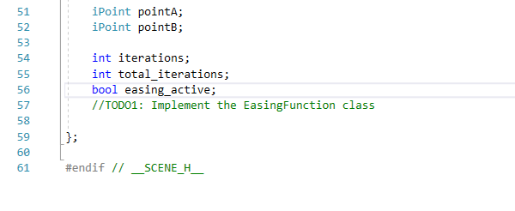
TODO1

Slide 8
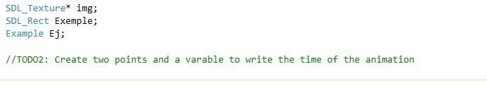
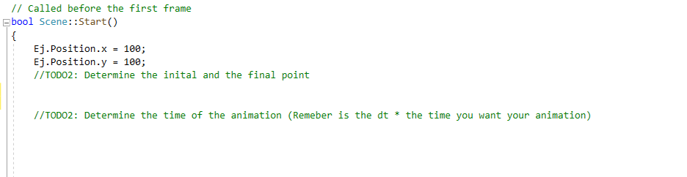
TODO 2

Slide 9
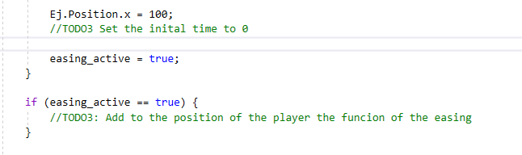
TODO 3

Slide 10
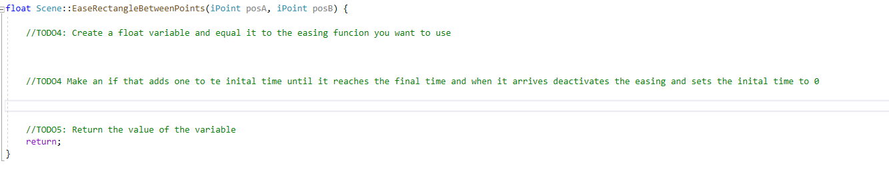
TODO 4 & 5

